Slide 1
Block-Sorting Robot Arm* Using DQN
Takara Busby, Tomas Garcia, Marcus Ramirez
*simulated in pybullet :(

Slide 2

Overview
Design & implement a 6 Degrees of Freedom (DOF) robotic arm to grab and sort colored blocks in a simulated environment
Leverage Deep Q-Learning to optimize behavior w/ iterative interactions
Ensure precise object detection and manipulation based on visual input
Design a system adaptable for real-world deployment beyond simulation

Slide 3
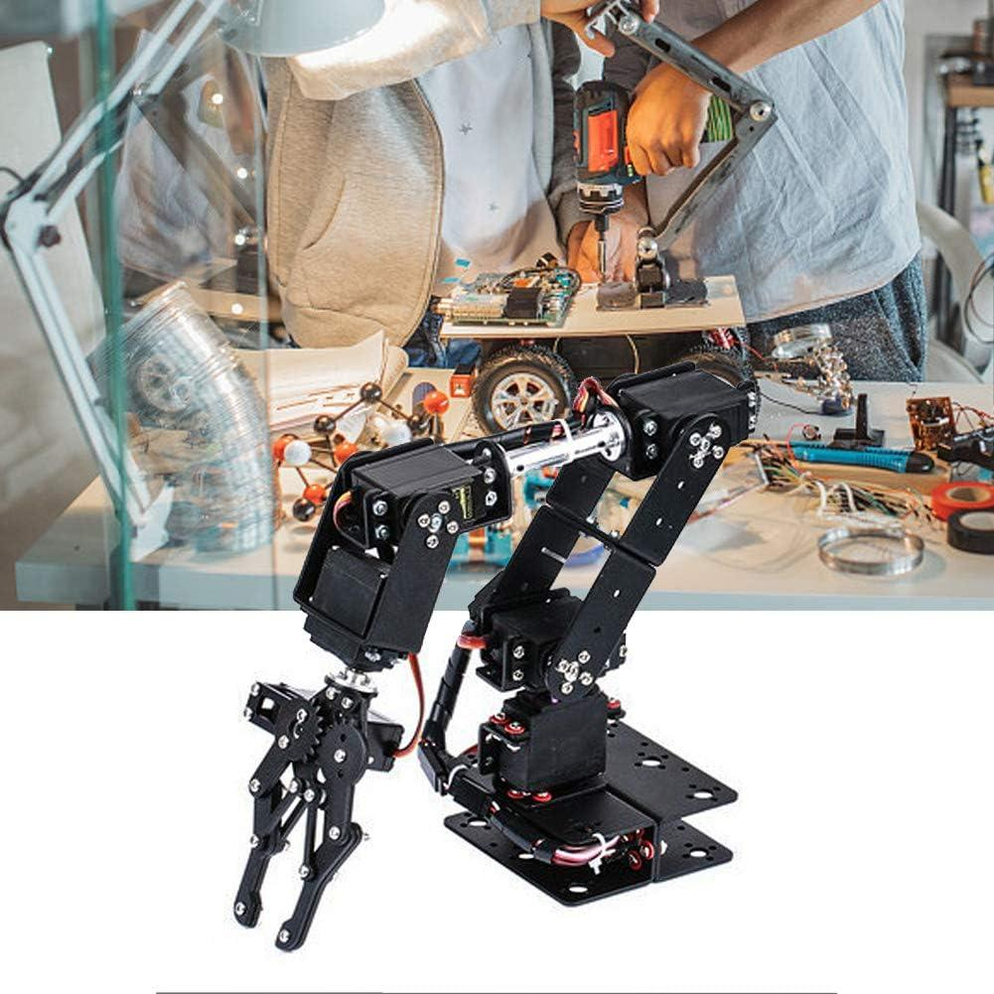
Objectives
Develop Robotic Autonomy: Train a 6 DOF robotic arm to grab and sort blocks based on color using Deep Q-Learning.
Simulated Environment: Leverage PyBullet for controlled, iterative training and real-time decision-making.
Precision and Scalability: Ensure accurate object detection and manipulation with potential for real-world deployment.
Overcome Traditional Limitations: Replace exhaustive manual programming with adaptable, reinforcement learning-based control.

Slide 4

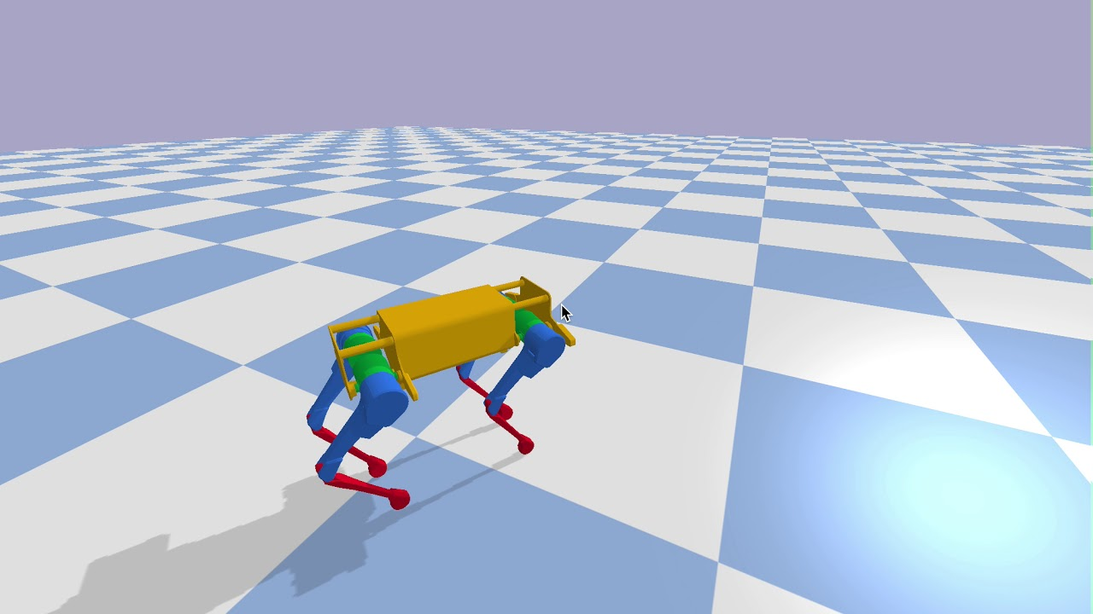

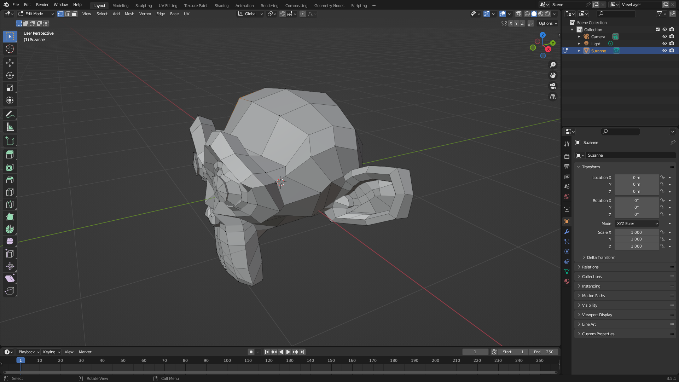

Software Used
PyBullet
PyTorch
Blender
Google CoLab
Hardware Exclusive:
OpenCV
Picamera2
GPIOZero

Slide 5
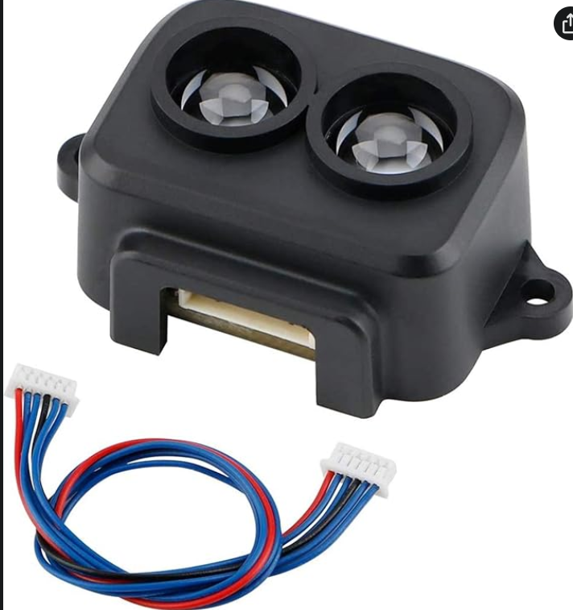
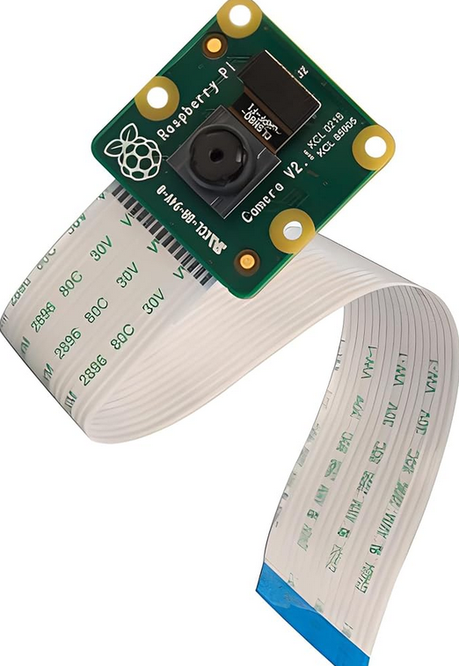
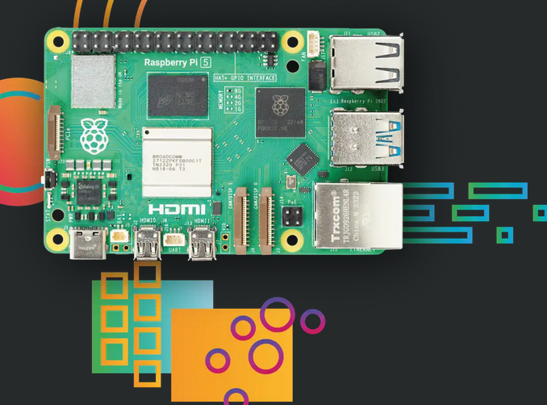
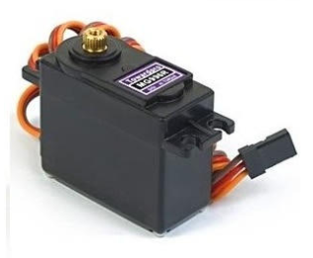
Hardware

Slide 6

Hardware (Cont.)
Robotic Arm Kit: Hobby Robot Arm Kit, equipped with 6 MG996R Servos.
Raspberry Pi 5: Microcomputer, serves as the controller for the robot and the host for the model
Camera: Provides visual input to detect colors and positions of blocks and the arm
Lidar Sensor: Narrow light beam used for depth perception, 2 degree FOV
Power Source: 7.2v NiMH battery, 3200mAh

Slide 7

Experimentation
Live testing?
Lidar Sensor setbacks
Bad Serial Port information flow
Dual camera input
Tedious calibrating
Socket communication
Awful dataflow for training if connection sucks
Fresno State wifi does indeed suck
Simulation Environment:
Gazebo/Ros2
Steep learning curve + tedious to set up
PyBullet

Slide 8
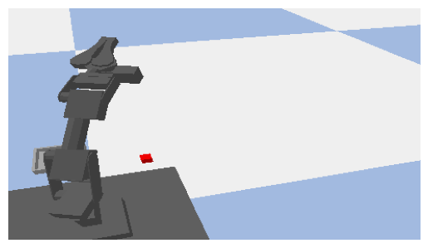
State & Action Space
State_Space
All the different combinations of Servo angles
With accompanying image of scene
Includes different position of block and tray
Action_Space
729 possible actions
Each servo has 3 possible actions
Move forward
Move backward
Don’t move
With six servos the permutations of this is 729

Slide 9
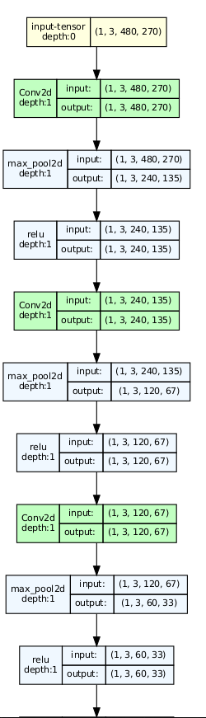
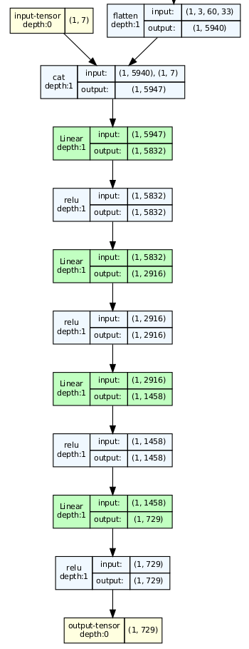
Neural Network
7 layer Network
3 are CNN’s
Kernel size of 3x3 with padding of 1
Each does max pooling with kernel_size of 2
4 are Fully connected
Output size of 729

Slide 10
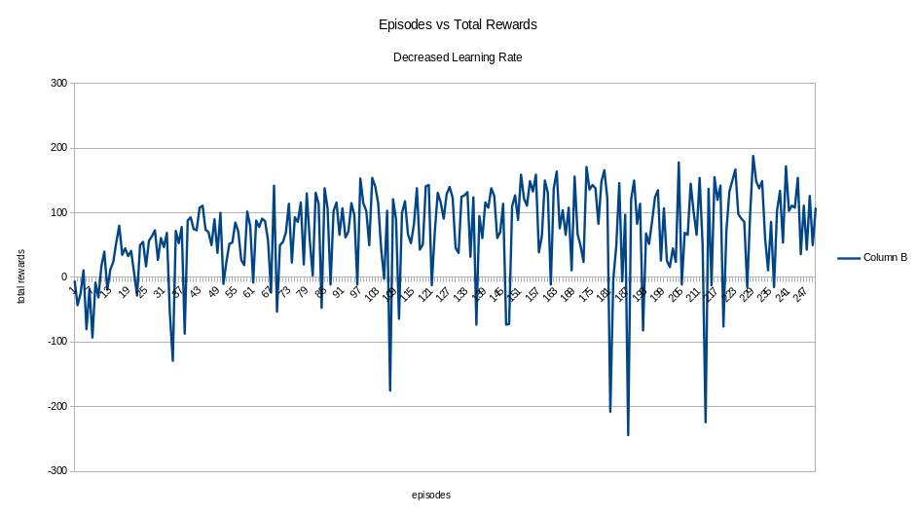
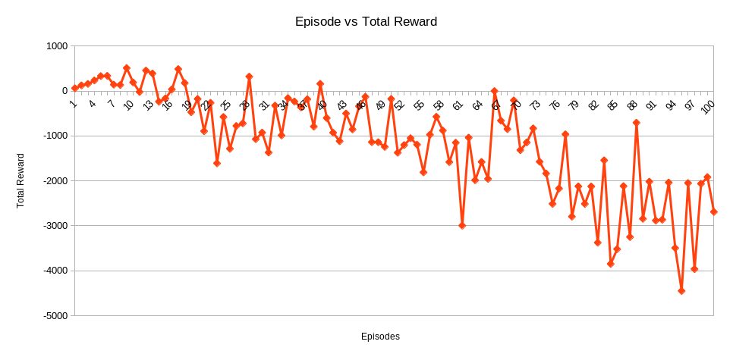
Results
Increased max duration to 1000
Lowered Learning Rate

Slide 11
Future Endeavors
Continue with training and hyperparameter tuning to get model to a desirable state
Reintroduce Lidar Sensor into virtual simulation
Actually implement in the real-world!
Most algorithms exist, just need to tie it all together

Slide 12
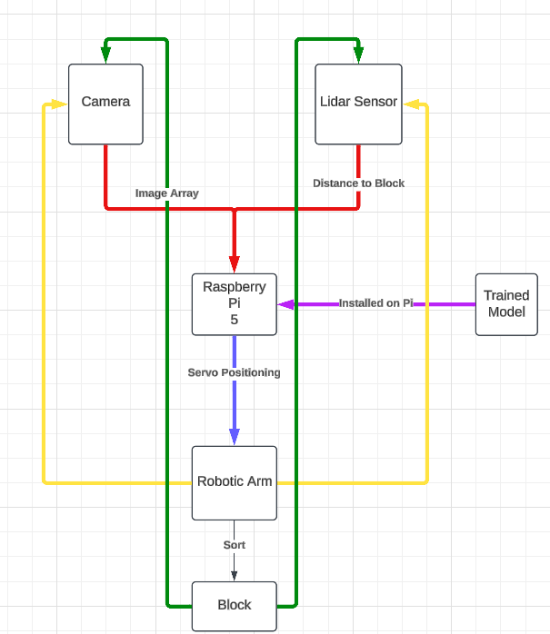
Hardware Setup - Flow Diagram

Slide 13
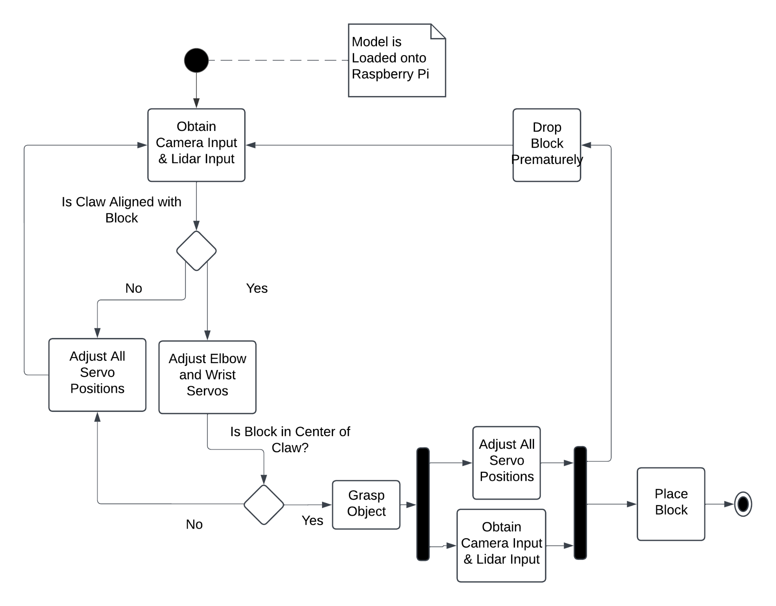
Hardware Setup - Activity Sequence

Slide 14
Conclusion
In conclusion we’re happy with the progress and knowledge acquired in the development of the Robotic Claw.
Simulation proved to be a difficult undertaking & a significant time allotment should be considered when embarking on a similar project.
Training model successfully requires hyperparameter fine-tuning + other adjustments also leading to significant time dedicated to this portion of the project.

Slide 15
References
About. OpenCV. (2020, November 4). https://opencv.org/about/
Paszke, A., & Towers, M. (n.d.). Reinforcement learning (DQN) tutorial¶. Reinforcement Learning (DQN) Tutorial - PyTorch Tutorials 2.5.0+cu124 documentation. https://pytorch.org/tutorials/intermediate/reinforcement_q_learning.html
MakerPortal. (n.d.). tfluna-python. GitHub.https://github.com/makerportal/tfluna-python.
Dr. David Ruby, CSUF

Slide 16

https://github.com/PSX-Ramitas/CSCI-166

